Slide 1
Agriculture- Crop and yield Predictor
Team Multiverse

Slide 2


Agenda
A
Introduction
Primary goals
The Problem
The Solution
Our Model
Future Scope

Slide 3
Introduction
Agriculture and associated sectors account for roughly 18 percent of India's Gross Value Added (GVA).
A large-scale, ill-informed decision by farmers could have a severe impact on the entire economy of a region.

Slide 4
Primary goals
Build a system that can provide Indian farmers with predictive insights, allowing them to make better decisions about increased crops revenue growth

Slide 5
Green is the path of our better future
“
”
Anonymous

Slide 6
Introduction
Agriculture in India is livelihood for a majority of the population and can never be underestimated. However, the agricultural sector is going through most stressed phase in the last three decades.
Indian agriculture is plagued by several problems; some of them are natural and some others are man-made.
Nearly three-quarters of India’s families depend on rural incomes. Every solution if rightly executed can make a huge difference.

Slide 7
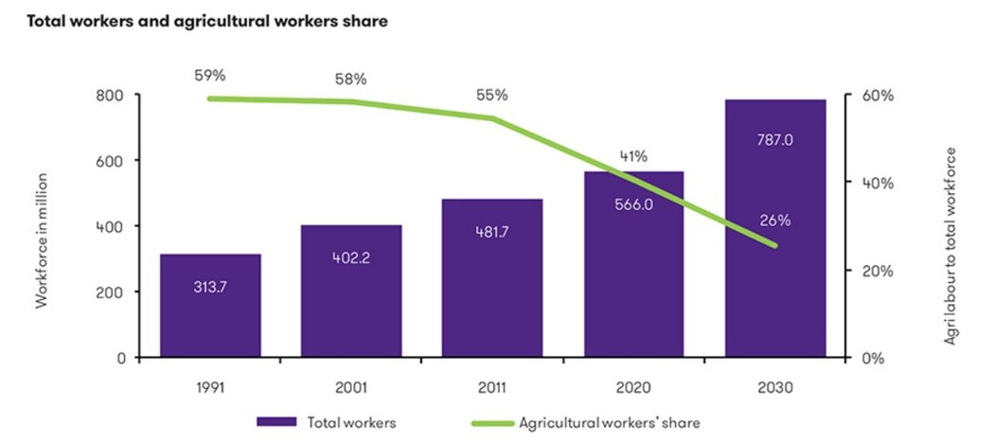
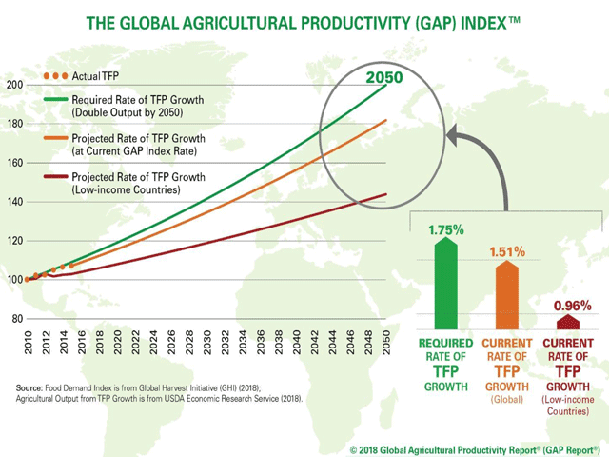
Here we see that as the years are progressing the number of workers in the agricultural sector are decreasing but there is a constant increasing demand for agricultural supply
WHAT IS THE REASON ????

Slide 8
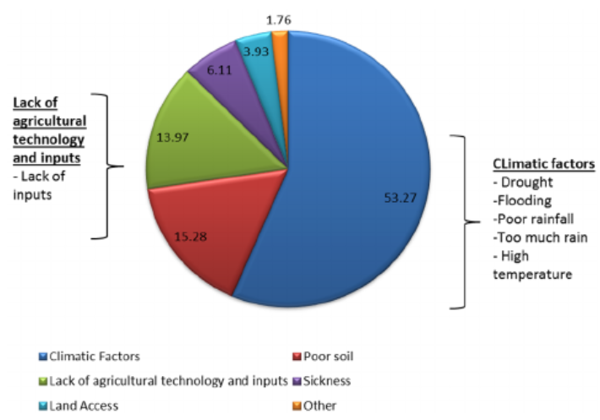
We see that the most major cause for crop failure is lack of agricultural inputs and mispredicted climatic conditions

Slide 9
The Problem
In most circumstances, a farmer's decision on which crop to cultivate is impacted by his intuition as well as other irrelevant aspects such as generating fast profits, being oblivious of market demand, overestimating the potential of a soil, and so on.
The farmer's unwise decision could put his family's financial status under severe strain. Perhaps this will lead to debt, which is one of the numerous contributing factors to the significant number of farmer suicides and decline in the number of farmers

Slide 10
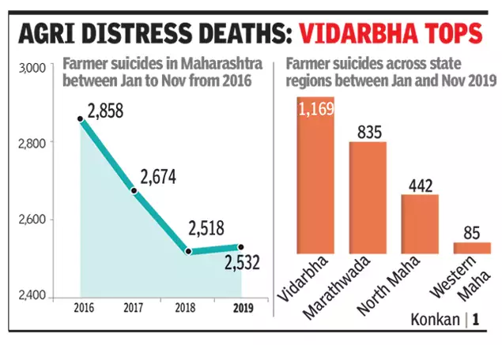

Slide 11
The Solution
We propose an Intelligent Crop Recommendation and Yield prediction system using Machine Learning that predicts crop suitability by factoring all relevant data such as temperature, rainfall, location, and soil condition.
The Yield is predicted based on the parameters of area of land available, agricultural season and the past observations of yield prediction
This system is primarily concerned with performing Agro Consultants principal role, which is to provide crop recommendations to farmer and the expected yield for that crop.

Slide 12
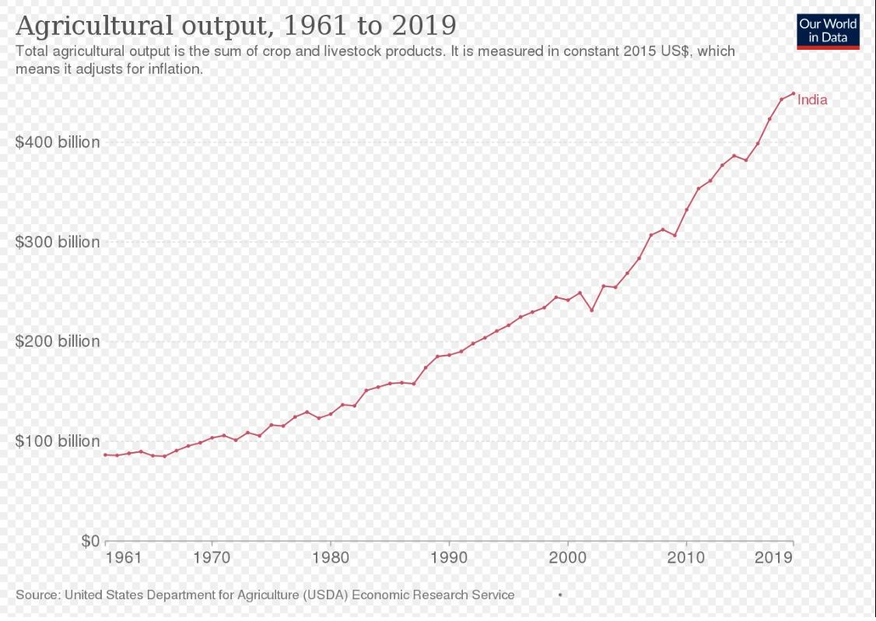

Slide 13
Our Model
Our model first predicts the most relevant crop that can be grown given the solid characteristics namely N(Nitrogen), P(Phosphorus), K(Potassium), and the weather of the region namely Temperature, Humidity, Ph, Rainfall and Labels of crops.
Then, it focuses on predicting the crop yield in advance by analyzing factors like district (assuming same weather and soil parameters in a particular district), state, season, crop type using various supervised machine learning techniques. This helps the farmers to know the crop yield in advance to plan and choose a crop that would give a better yield.

Slide 14
Data Dictionary:
Dataset(Crop Recommendation) consists of 8 variables where 7 variables are considered for predicting output variable. The details of Variable is given Below
%N (Nitrogen) : Nitrogen content in the soil. Nitrogen is really important for plant growth (structure), plant food processing (metabolism), and the creation of chlorophyll. Without enough nitrogen in the plant, the plant cannot grow taller, or produce enough food (usually yellow).
%P (Phosphorus) : Phosphorus content in the soil. Phosphorus primary role in a plant is to store and transfer energy produced by photosynthesis for use in growth and reproductive processes. Soil P cycles in a variety forms in the soil
%K (Potassium) : Potassium content in the soil. Potassium is an essential nutrient for plant growth.
Temperature : Temperature in degree celsius. High temperatures affect plant growth in numerous ways. The most obvious are the effects of heat on photosynthesis, in which plants use carbon dioxide to produce oxygen, and respiration, an opposite process in which plants use oxygen to produce carbon dioxide.
Humidity : Relative humidity in %. When conditions are too humid, it may promote the growth of mold and bacteria that cause plants to die and crops to fail, as well as conditions like root or crown rot. Humid conditions also invite the presence of pests, such as fungus gnats, whose larvae feed on plant roots and thrive in moist soil.
PH : ph value of the soil. Plant nutrients leach from the soil much faster at pH values below 5.5 than from soils within the 5.5 to 7.0 range. In some mineral soils aluminum can be dissolved at pH levels below 5.0 becoming toxic to plant growth. Soil pH may also affect the availability of plant nutrients.
Rainfall : Rainfall in mm. Plants use the moisture in the soil to replenish the water lost through transpiration. If there is no water in the soil, the leaves will wilt. As more water is lost, the plant will fail and eventually die. Rainwater builds up the moisture levels in the soil and assures a healthy plant. Finally,
Label : This is the output variable which contains 22 unique values i.e., 22 different crops and they are ['Apple','Banana','blackgram','chickpea','coconut','coffee','cotton','grapes','jute','kidney beans','lentil','maize','mango','moth beans','mung bean','muskmelon','orange','papaya','pigeonpeas','pomegranate','Rice','Watermelon']
Exploratory data analysis carried out to fetch insights from the data.

Slide 15
Data Dictionary:
Dataset(Crop Production) consists of 7 variables where 5 variables are considered for predicting output variable. The details of Variable is given Below
Crop_Year : It gives the year the crop is grown in
Area : It is the area of Agricultural field the crop is grown in
Production : Total crop production, i.e, prediction once the year and area are given as inputs to the model
Season : Current Season of crop growth
Type of Crop : The name of the crops
ALL THE DATASETS USED ARE TAKEN FROM KAGGLE

Slide 16
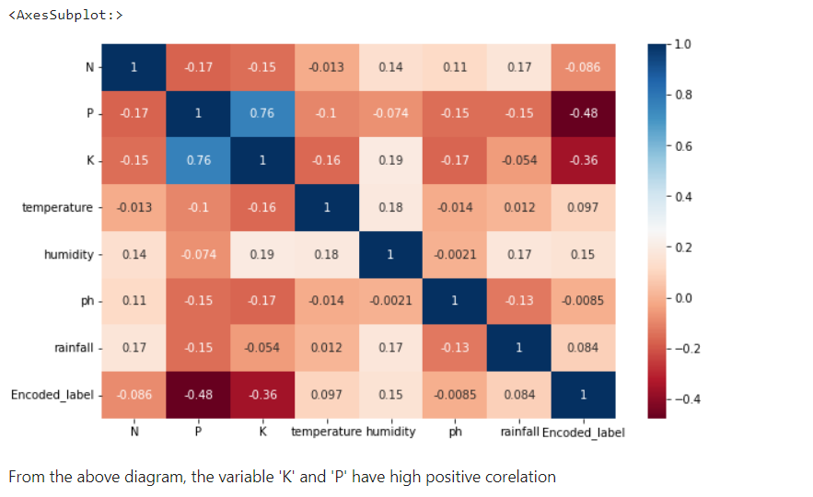
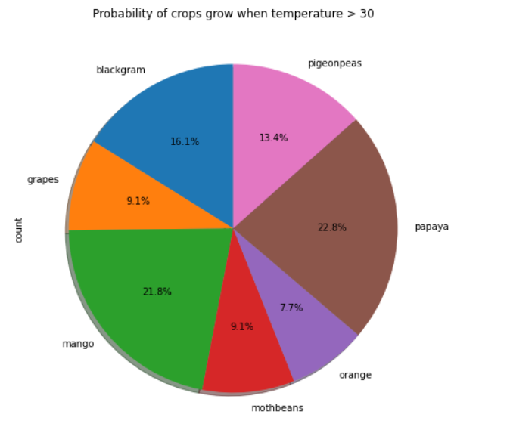
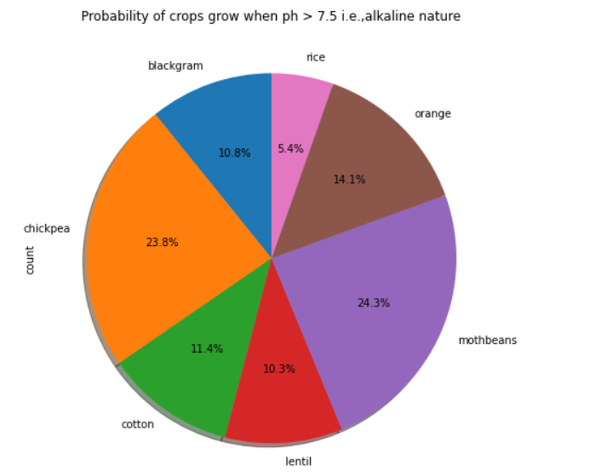
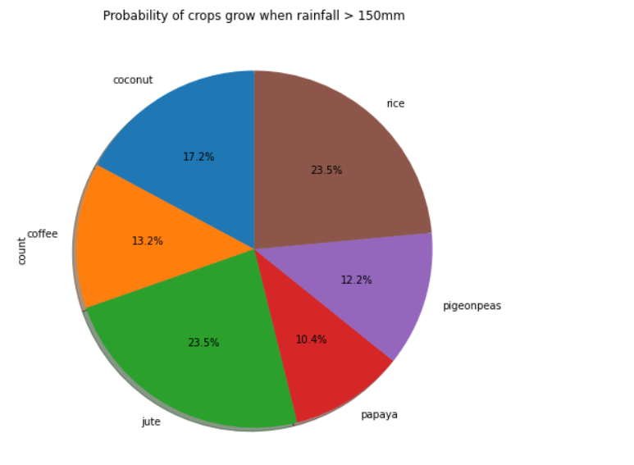

Slide 17
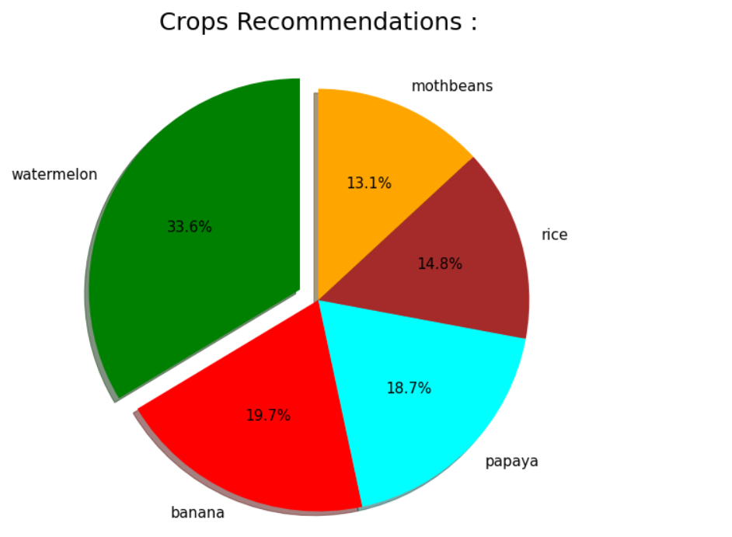
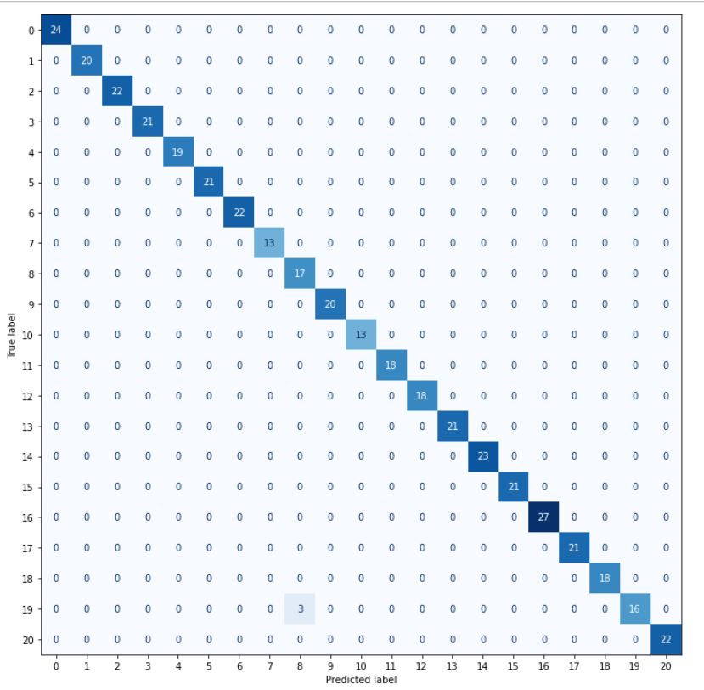
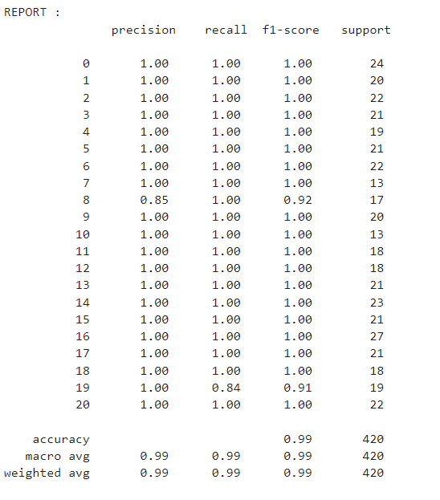
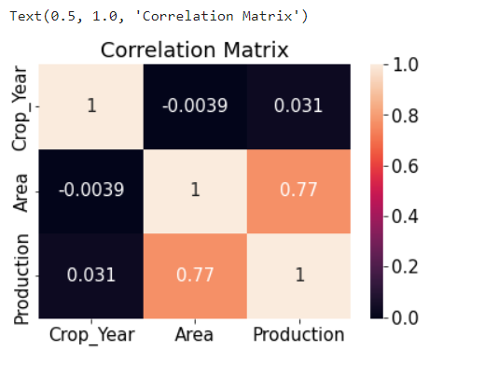

Slide 18
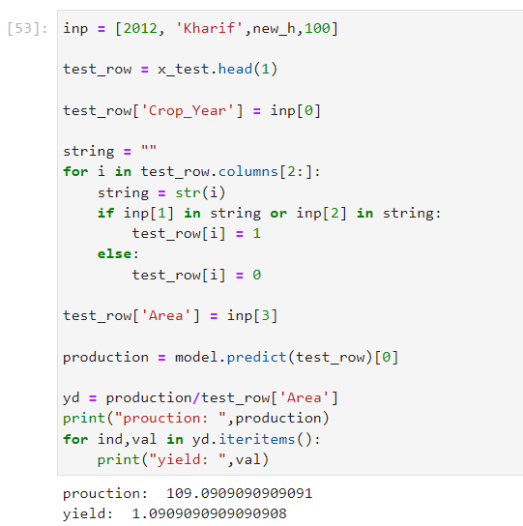
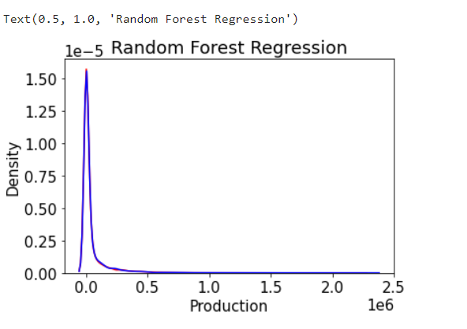

Slide 19
Future Scope
Can give prescriptive analysis on how to grow a desired crop by a farmer on his field if currently not possible under the current land conditions by prescribing what changes need to be done on the land (increasing/decreasing pH,N,P and K)
Thus the farmer can choose to grow a crop which is in demand and which will provide him with maximum yield.
hence MAXIMISING his PROFITS !!

Slide 20






Meet our team
Arnav Kumar
Emil Bluemax
J.P.Daniel Christopher​
Karan Chouhan
Vijith BG
Zain Muhammed​

Slide 21
Thank you
Team Multiverse

